Slide 1



Identification of Redundant Code Using AI
Jaypee University of Information Technology
Department of Computer Science and Engineering and Information Technology
Major Project - II (18B19CI891) | AY 2024-25
End-Term Evaluation | May 16-17, 2025.
Group No.: 86
Team Member (s)
Piyush Joshi (211397)
Samriti Thakur (211150)
Prakhar Varshney (211327)
Supervisor (s)
Dr. Ramesh Narwal
Assistant Professor
CSE&IT
Ms. Seema Rani
Assistant Professor
CSE&IT

Slide 2
Outline
Introduction
Problem Statement
Objectives
Work Done (after Mid-Term Evaluation)
Project Design
Implementation
Experimental Results and Evaluation
Key Learnings
Future Work
Work Contribution and Attendance
Supervisor Interactions
References

Slide 3
Introduction
Code redundancy, or duplicated code (code clones), is a common issue in software development. It occurs when developers replicate code segments to save time or due to a lack of collaboration. While this may seem convenient initially, redundant code increases codebase size, complicates maintenance and can introduce inconsistencies or bugs when updating code.
The "Identification of Redundant Code Using AI" project aims to address this challenge by employing machine learning (ML) and natural language processing (NLP) techniques. Using advanced ML models, the project will automatically identify both exact and semantic code clones. By training on a dataset of labeled redundant code patterns, the system will be able to detect clones across large codebases, highlighting areas for refactoring and improving code quality.
This AI-based approach will streamline code maintenance, reduce duplication, and contribute to more efficient software development practices by producing cleaner more maintainable code.

Slide 4
Problem Statement
Code redundancy, or "code clones," occurs when identical or near-identical code segments are scattered across a codebase due to copy-pasting or unintentional duplication.
This leads to increased codebase size, makes maintenance more difficult, and introduces the risk of inconsistencies when changes are applied to only one instance of a clone.
Traditional methods, like manual reviews or text-based detection, often miss "near-miss" clones, where minor changes exist, or semantic clones, where the code behaves the same but looks different.
As codebases grow, manual identification and refactoring of redundant code becomes impractical, resulting in decreased efficiency and increased technical debt.
The need arises for an automated solution capable of detecting both exact and semantic code clones to help developers maintain cleaner, more efficient codebases.

Slide 5
Objectives
Automate Detection of Code Clones: Develop an AI-based system that can efficiently detect both exact and semantic code clones across large codebases, reducing the manual effort involved in identifying redundant code.
Improve Codebase Quality: Minimize code duplication and technical debt by identifying areas of the code that can be refactored, ensuring cleaner, more maintainable, and scalable software development.
Enhance Development Efficiency: Provide developers with actionable insights through automated clone detection reports, enabling quicker identification of redundant code and faster resolution during the development and maintenance processes.
Create a User-Friendly Tool for Code Clone Detection: To develop an intuitive and effective tool that integrates the AI model and allows users to easily scan their codebases for redundant code patterns.

Slide 6
Work Done (after Mid-Term Evaluation)
Model Development & Training:
Implemented and trained multiple architectures:
LSTM, Bidirectional LSTM, GRU with Attention and Transformer.
Integrated embedding, sequence handling, and dropout for optimization.
Model Loading & Inference Pipeline:
Built a CLI-based prediction system to test new code pairs.
Enabled input via both code files and direct string input.
Ensured consistency with the training pipeline during inference.
Evaluation & Visualization:
Added tools for evaluating trained models using Confusion Matrix, ROC Curve, Precision-Recall Curve, Redundancy Score Distribution.

Slide 7
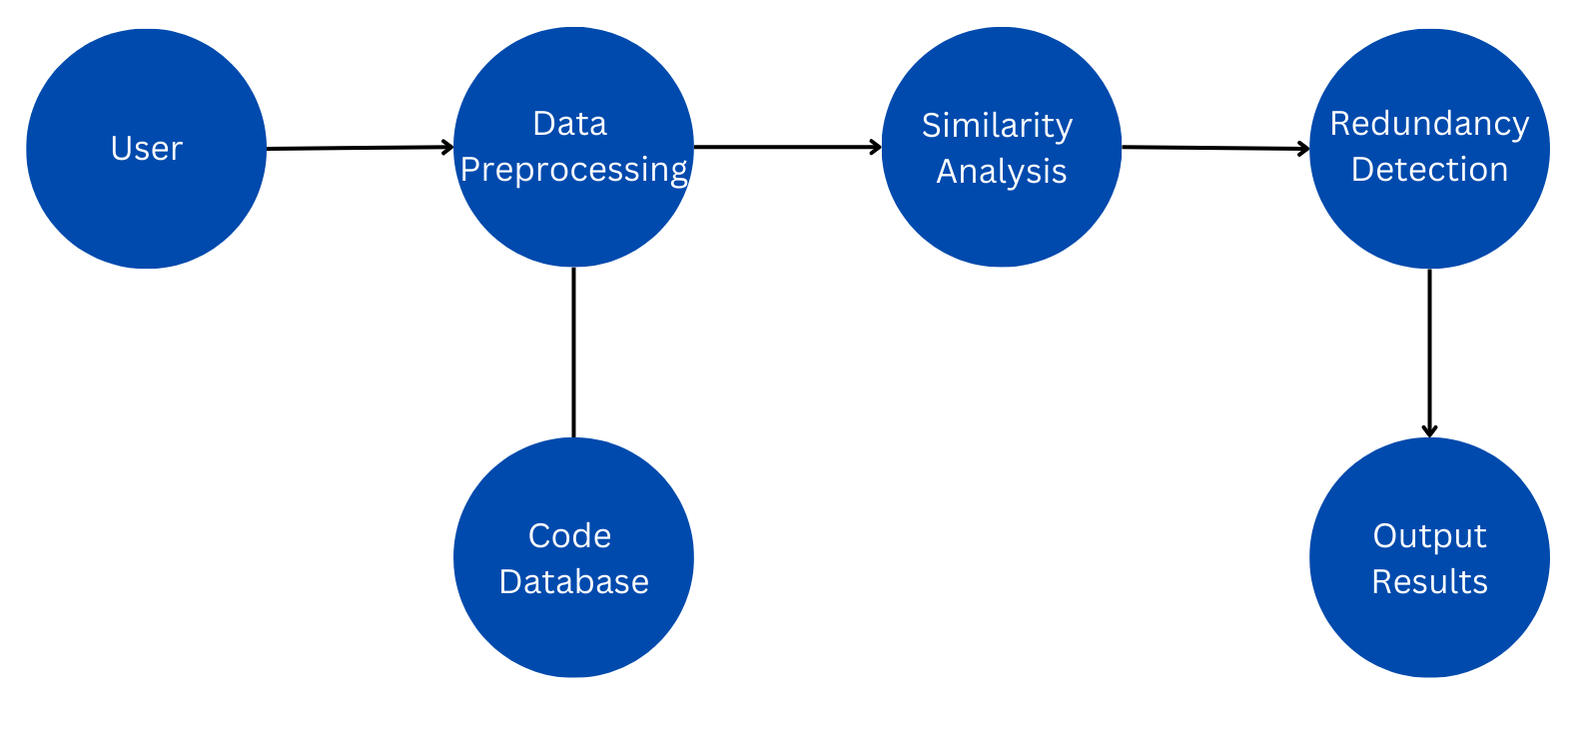
Project Design
Data Flow Diagram (DFD) for Redundant Code detection System.
Figure 1
Redundant Code detection Flow chart

Slide 8
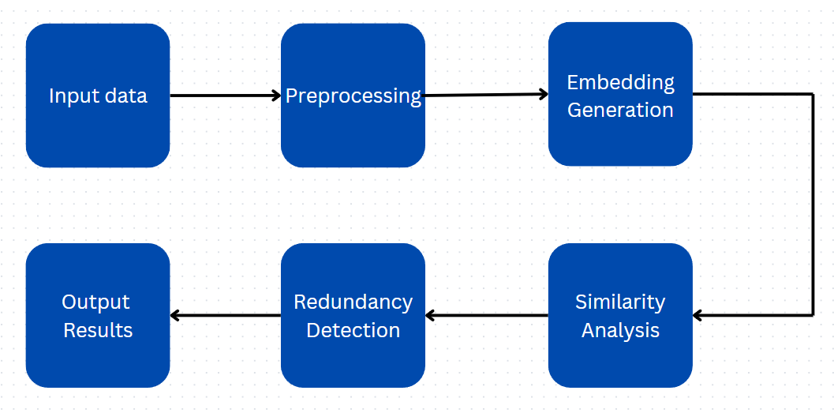
Project Design (cont…)
Project Design (cont…)
Project Design (cont…)
Data Flow Diagram (DFD) for Redundant detection model.
Figure 2
Redundant detection model data flow diagram

Slide 9
Project Design (cont…)
Module Interactions
Dataset Module: Loads pre-converted 50,000 JSON code pairs.
Preprocessing Module: Tokenizes, pads and cleans code text.
Embedding Layer: Converts code tokens to vector form using trainable embeddings.
Model Module: Core LSTM-based classifier with optional bidirectionality or attention.
Evaluation Module: Generates confusion matrix, ROC, PR curves and accuracy metrics.
Key Design Decisions
JSON-based Dataset Format: Enables scalable input/output with clear labels.
Deep Sequential Models: Chosen for handling varying code lengths and semantic structure.
Balanced Pairing Logic: Ensures 1:1 ratio of redundant vs. non-redundant samples.

Slide 10
Implementation
Dataset Overview
Format: JSON file with 50,000 entries of code pairs.
Structure:
{ "code1": "<code snippet 1>",
"code2": "<code snippet 2>",
"label": 0 or 1 }
Label:
1 → Code snippets are redundant (similar logic/functionality).
0 → Code snippets are non-redundant.
Characteristics:
Balanced Dataset: Equal distribution of positive (1) and negative (0) pairs.
Comments retained for real-world relevance.
Ready-to-use for model input generation (tokenization + padding).

Slide 11
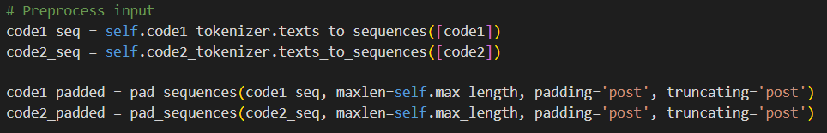
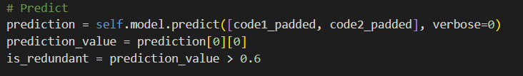
Implementation (cont…)
Tokenization and Padding:
Converts code into numerical format compatible with deep learning models.
Model Architectures Used:
Bidirectional LSTM, GRU with Attention, Transformer Encoder.
Configurable through model loader; trained to output similarity score ∈ [0, 1].
Prediction Logic:
A threshold of 0.6 is used to determine redundancy.

Slide 12
Implementation (cont…)
End-to-End Workflow
Input: JSON dataset loaded into memory.
Preprocessing: Code pairs tokenized and padded.
Model: Pre-trained architecture loaded via CodeRedundancyPredictor.
Inference:
Each pair passed to model → score computed.
Score evaluated against threshold for classification.
Evaluation:
Metrics: Accuracy, Precision, Recall, F1-score.
Visuals: Confusion matrix, ROC, PR curve, Redundancy score distribution.
6. Key Components:
CodeRedundancyPredictor: Manages loading, tokenization, and prediction.
predict(), predict_batch(), predict_from_files(): Methods for different input modes.

Slide 13
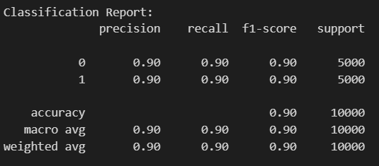
Experimental Results and Evaluation
Model Evaluation Metrics
Model Used: Transformer-based Code Similarity Detection Model
Dataset: 50,000 labeled code pairs (25,000 similar, 25,000 dissimilar)
Test Set Size: 10,000 code pairs.
Overall Accuracy: 90%.
Balanced classification across both redundant and non-redundant pairs.
No class imbalance issues observed during evaluation.

Slide 14
Experimental Results and Evaluation (cont…)
Comparison with Existing Approaches
Baseline Methods Explored:
Cosine Similarity + TF-IDF:
Simple text-based comparison of code.
Issue: Struggles with semantic similarity when variable/function names differ.
AST (Abstract Syntax Tree) Similarity:
Examines structural similarity of code.
Issue: Doesn't capture logic-level redundancy across different implementations.
2. Why Our Dataset Matters?
Pairs generated programmatically → Removes subjectivity in manual labeling.
Covers a wide range of problem-solving techniques → Useful for real-world redundancy detection.
Scalable & adaptable → Can support different programming languages in the future.

Slide 15
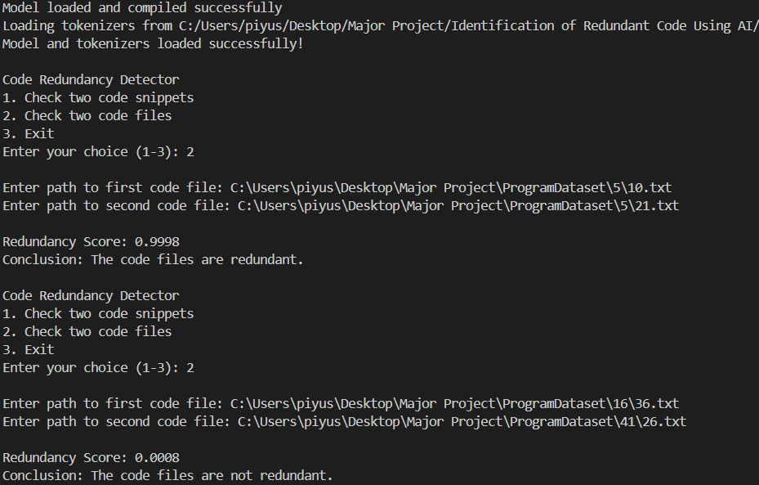
Experimental Results and Evaluation (cont…)
Final CLI based output of the redundancy detection model:

Slide 16
Key Learnings
Technical Concepts:
Code Representation & Preprocessing: Learned to tokenize, normalize, and structure raw code for model-ready input using techniques like sequence padding and vocabulary mapping.
Deep Learning for NLP on Code: Implemented and experimented with LSTM, Bi-LSTM, GRU with attention, and Transformer architectures tailored to source code understanding.
Semantic Similarity Measurement: Gained insight into how deep models learn functional similarity beyond syntax, enabling redundancy detection between logically equivalent programs.
Methodologies Practiced:
Supervised Learning with Balanced Dataset Creation.
Model Saving, Loading, and Reusability for Deployment Scenarios.
Error Analysis to Refine Labeling and Architecture Choices.

Slide 17
Future Work
Model Improvements
Integrate Large Language Models (LLMs) like CodeBERT or GraphCodeBERT to enhance semantic understanding of code.
Ensemble Architectures: Combine LSTM, Transformer and attention-based models for better redundancy detection accuracy.
Scalability & Deployment
Develop an interactive web interface for real-time redundancy checking.
Deploy model as an API for integration with coding platforms or plagiarism tools.
Extended Applications
Add the functionality to give suggestions to improve the code.
Adapt the system for partial redundancy detection within larger codebases.

Slide 18
Work Contribution and Attendance
GitHub Repository URL:
Team Member | Roll No. | Work Done (provide complete details) | Work Contribution (%) | Lines of Code (LoC) | Lab Attendance (%)
1. | 211397 | Worked on the development of dataset. Worked on developing scripts for model training and loading. Worked on documenting the project report. | 33%
2. | 211150 | Contributed in the development of dataset. Worked on development of the model.. Worked on documenting the project report and ppt. | 33%
3. | 211327 | Contributed in the development of dataset. Worked on developing scripts for loading model and making prediction. Worked on documenting the project report and ppt. | 33%

Slide 19
Supervisor Interactions (as mentioned in weekly log)
No. of Meetings with Supervisor:
Week No. | Duration | Remarks (as mentioned in the weekly log) | Incorporated (Yes/No)
1. | 24/03/2025 to 29/03/2025 | Remark 1 Remark 2 Remark 3 | Yes
2. | 31/03/2025 to 05/04/2025 | Remark 1 Remark 2 Remark 3 | Yes
3. | 07/04/2025 to 12/04/2025 | Remark 1 Remark 2 Remark 3 | Yes
4. | 14/04/2025 to 19/04/2025 | Remark 1 Remark 2 Remark 3 | Yes
5. | 21/04/2025 to 26/04/2025 | Remark 1 Remark 2 Remark 3 | Yes

Slide 20
Supervisor Interactions (cont…)
Week No. | Duration | Remarks (as mentioned in the weekly log) | Incorporated (Yes/No)
6. | 28/04/2025 to 03/05/2025 | Remark 1 Remark 2 Remark 3 | Yes
7. | 05/05/2025 to 10/05/2025 | Remark 1 Remark 2 Remark 3 | Yes
8. | dd/mm/2025 to dd/mm/2025 | Remark 1 Remark 2 Remark 3
9. | dd/mm/2025 to dd/mm/2025 | Remark 1 Remark 2 Remark 3
10. | dd/mm/2025 to dd/mm/2025 | Remark 1 Remark 2 Remark 3

Slide 21
References
[1] Feng, Z., Guo, D., Tang, D., Duan, N., Feng, X., Gong, M., Shou, L., Qin, B., Liu, T., Jiang, D. and Zhou, M., 2020. Codebert: A pre-trained model for programming and natural languages. arXiv preprint arXiv:2002.08155.
[2] Svajlenko, J. and Roy, C.K., 2015, September. Evaluating clone detection tools with bigclonebench. In 2015 IEEE international conference on software maintenance and evolution (ICSME) (pp. 131-140). IEEE.
[3] Kim, D.K., 2019. Enhancing code clone detection using control flow graphs. International Journal of Electrical & Computer Engineering (2088-8708), 9(5).
[4] Swaraj, A. and Kumar, S., 2023. Programming Language Identification in Stack Overflow Post Snippets with Regex Based Tf-Idf Vectorization over ANN. In ENASE (pp. 648-655).
[5] Ragkhitwetsagul, C., Krinke, J. and Clark, D., 2018. A comparison of code similarity analysers. Empirical Software Engineering, 23, pp.2464-2519.
[6] Ain, Q.U., Butt, W.H., Anwar, M.W., Azam, F. and Maqbool, B., 2019. A systematic review on code clone detection. IEEE access, 7, pp.86121-86144.
[7] Van Rysselberghe, F. and Demeyer, S., 2003, September. Evaluating clone detection techniques. In Proc. Int’l Workshop on Evolution of Large-scale Industrial Software Applications (ELISA) (pp. 25-36).

Slide 22
References (cont…)
[8] R. Smith and S. Horwitz, “Detecting and measuring similarity in code clones,” *ResearchGate*, 2009.
[9] Martin White, Michele Tufano, Christopher Vendome, and Denys Poshyvanyk : “Deep Learning Code Fragments for Code Clone Detection”,2015.
[10] Neha Saini, Sukhdip Singh, Suman : Code Clones: Detection and Management . In International Conference on Computational Intelligence and Data Science (ICCIDS 2018) .
[11] Dong Kwan Kim :Enhancing code clone detection using control flow graphs. In International Journal of Electrical and Computer Engineering (IJECE) Vol. 9, No. 5, October 2019, pp. 3804~3812 ISSN: 2088-8708, DOI: 10.11591/ijece.v9i5.pp3804-3812 .
[12] Ajad Kumar, Rashmi Yadav and Kuldeep Kumar: A Systematic Review of Semantic Clone Detection Techniques in Software Systems. IOP Conf. Series: Materials Science and Engineering 1022 (2021) 012074.
[13] Morteza Zakeri-Nasrabadi, Saeed Parsa , Mohammad Ramezani, Chanchal Roy, Masoud Ekhtiarzadeh : A systematic literature review on source code similarity measurement and clone detection: Techniques , applications ,and challenges.The Journal of Systems & Software 204 (2023) 111796.

Slide 23
References (cont…)
[14] IEEE Transactions on Power Systems, vol. 32, no. 3, pp. 2142-2151, May 2017.
[15] K. A. Kontogiannis, R. De Mori, E. Merlo, M. Galler, and M. Bernstein, "Pattern Matching for Clone and Concept Detection," Automated Software Engineering, vol. 3, pp. 77–108, 1996
[16] Z. A. Alzamil, "Application of Redundant Computation in Program Debugging," Journal of Systems and Software, vol. 81, no. 11, pp. 2024–2033, Nov. 2008.
[17] M. Zhang, "Detecting Redundant Operations with LLVM," GSoC 2015 Proposal, unpublished, 2015.
[18] Marcus, A., & Maletic, J. I. (2001). Identification of High-Level Concept Clones in Source Code. Proceedings of the International Conference on Automated Software Engineering (ASE '01), pp. 46-53.
[19] Zhou, T., Tian, R., Ashraf, R. A., Gioiosa, R., Kestor, G., & Sarkar, V. (2022). ReACT: Redundancy-Aware Code Generation for Tensor Expressions. Proceedings of the International Conference on Parallel Architectures and Compilation Techniques (PACT '22).
[20] Xu, Z., & Sheng, V. S. (2024). Detecting AI-Generated Code Assignments Using Perplexity of Large Language Models. Proceedings of the AAAI Conference on Artificial Intelligence, 38(21), 23155-23162.

Slide 24

Thanks.

